Slide 1
STOCKS: INVESTING & TRADING
Presented by
Muhammad Mubashir
Notes:
Salam every body, the night is delightful and what better then a sales presentation in such a prestigious night ?
So lets get started with this. Hi, My name is Muhammad Mubashir is and I will be presenting a presentation on Stocks: investing and trading according to the model we have made and try to sell it to the ones new or seniors in the field

Slide 2
CONTENTS
Introduction
Functioning of Model
Summary
Usage of Model
Why Buy It ?
Notes:
Moving to the table of contents, there will be an introduction then I will describe you with a little functioning of the model later the usage of the model and why you should buy it. Later I’ll sum it all up into some sentences for all to take notes

Slide 3
INTRODUCTION
At UBIT Stock Consultants, we empower investors to maximize their portfolios to help them meet their financial goals responsibly. By offering customized and sophisticated strategies, we help clients' portfolios grow organically and foster a trusted consumer-consultant relationship.
Notes:
Talk, now being straight forward this was a copied line. what is means is to say that we help our customers to achieve their goals help them by interactive graphs with our strategies we provide short term closing dates of the markets to invest thoughtfully and with more effectiveness

Slide 4
TRADING & INVESTING
Stocks can be complicated and Volatile but getting started doesn’t have to be
Notes:
Stocks can be complicated and volatile but getting started does not have to

Slide 5
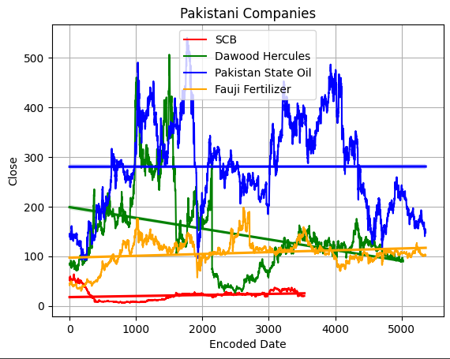
LONG-TERM VS. SHORT-TERM
Notes:
The graph provides the long term investment classification and based on the previous 22 years data we predict if it is worth the investment in long term
The short term is done via the machine learning model using random tree regressor

Slide 6
KSE-100 Stock Predictions
 | SCB | DH | PSO | FF
High | 20.1 | 93.49 | 151.88 | 102.5
Low | 20 | 93 | 147.15 | 101.52
Open | 20 | 93 | 150.84 | 102.5
Volume | 270000 | 9500 | 499718 | 107530
Notes:
The model bases on the following inputs to predict the closing price
The recent close or we can rephrase it as the today open
The high of the market
The low of the market

Slide 7
WEALTH IS THE ABILITY TO FULLY EXPERIENCE LIFE.
-Henry David Thoreau
Notes:
Some random quote

Slide 8
Functioning of Model
The Model is trained of Twenty-Two(22) years of data of PSX presently of 4 companies and 617 companies' predictions to be added in coming months if you take our subscription
Notes:
Read of the screen

Slide 9
Functioning of Model
Each company data dates to 2000 with present day data to make disastrously correct predictions, all contain minimum of 5000 days worth of data that contributes to prediction of your tomorrow financial decision.
Notes:
Read of the screen

Slide 10




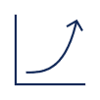
Usage of model
Step 1
Step 2
Step 3
Step 4
Step 5
Choose your subscription Plan
Based on our prediction Invest your Money
Have a cup of Tea and wat for the market to rise
Sell stakes on higher price as our prediction
Attain financial freedom

Slide 11
Why buy the subscription?
Portfolio diversification
Short and long-term goals
We ensure minimum loss in case of market crash
Message updates when stake needs to be shredded
Out of 690 companies invest in the best performing
Dividend Value prediction in upcoming updates
Create Financial freedom
Add a second stream of income for extended goals
Supplement retirement fund
Safeguard you and your family future
Notes:
Read of the screen

Slide 12
HOW TO GET THERE
Strategize
Minimize risk
Utilize resources
Do your research and develop a plan with goals
Diversify your portfolio through stock ownership​
Follow the markets closely
Follow market trends and upcoming giants in markets​
Be cautious of scams and "too good to be true" scenarios
Avoid "all-in" strategies
Apps and platforms help streamline user experience
Seek expert guidance from UBIT Stock Consultants team members​
Notes:
Read of the screen

Slide 13
SUMMARY
At UBIT stock consultants, we believe in giving out 110%. By using our next-generation data architecture, we help investors virtually manage their portfolios. We thrive because of our market knowledge and great team. Of course, the marks is disastrously volatile and what we offer is a 99% prediction model while 1% is what we thrive to safeguard. Here at UBIT Stock Consultants we ensure you that you and your trust is respected reciprocated and used in your advantage to help you achieve financial freedom.
Notes:
Read of the screen

Slide 14
THANK YOU
Mubashir & Daud​
Mubi@rip123.onmicrosoft.com
Daud@rip123.onmicrosoft.com
Notes:
Work emails

